Slide 1

Bank Customer Churn Analysis:
Analyzing churn patterns and insights

Slide 2

Hello!
In this project, I analyzed customer churn data from a bank to identify factors driving customer attrition. Using data from over 10,000 customers, I examined details like gender, credit card status, activity level, country, product usage, age, credit score, and account balance. I utilized SQL to perform joins and aggregations to derive meaningful insights, and Power BI for creating visualizations. This helped me uncover key insights and trends, such as churn rates by age group and credit score, aiming to improve customer retention strategies.

Slide 3
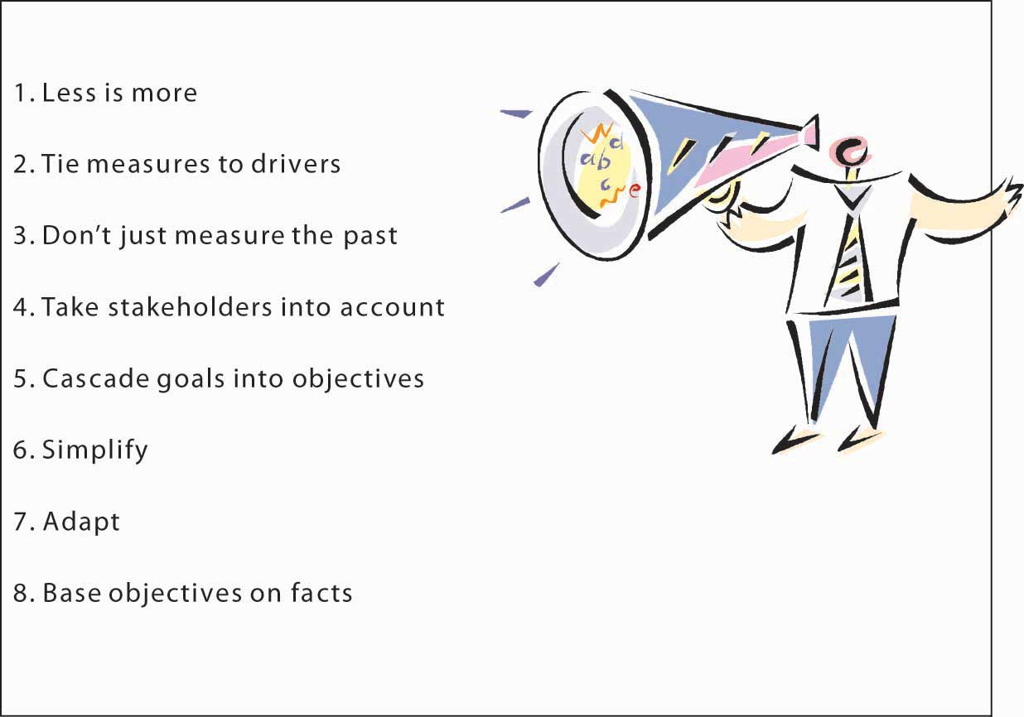
Objective:
Analyze customer data to uncover patterns and trends related to churn.
Generate actionable insights using SQL for detailed analysis.
Identify demographic, behavioral, and financial factors contributing to high churn rates.
Generate actionable insights to help the bank develop targeted retention strategies.
Visualize findings using Power BI to create clear and informative dashboards.

Slide 4

Outcomes
Churn Rate Variations: Analyzed churn rates across different customer demographics and financial profiles.
Dashboards: Created interactive Power BI dashboards to display customer churn patterns and trends.
Strategic Insights: Provided actionable recommendations based on the analysis to enhance customer retention strategies.
Enhanced Understanding: Improved the bank’s understanding of customer churn through detailed analysis and visualizations.
Informed Decision-Making: Supported decision-making with data-driven insights and clear visual representations.

Slide 5
Power Bi Report:

Slide 6
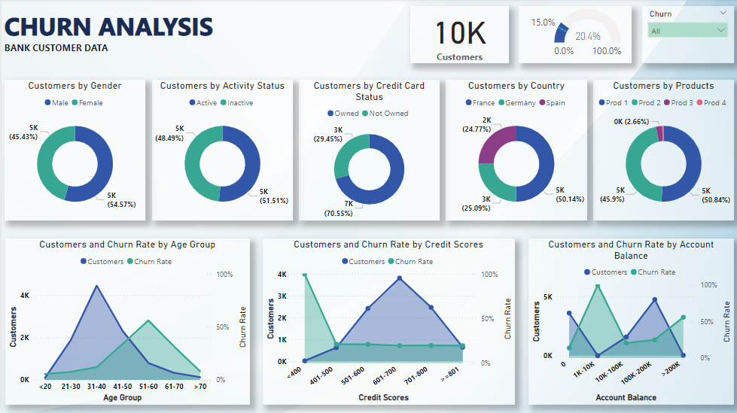

Slide 7

Insights:
High Churn Among Older Age Groups: The 51-60 age group has a churn rate of 56.2%, indicating a higher risk of customer attrition in this demographic.
Critical Impact of Credit Score on Churn: Customers with credit scores below 400 have a 100% churn rate, showing a strong correlation between low credit scores and customer loss.
High Churn for Wealthier Customers: Customers with account balances over 200k experience a churn rate of 55.9%, suggesting dissatisfaction among high-balance clients.
Product Usage Discrepancies: Product 1 has a usage rate of 50.84%, while Product 4 has minimal usage at 0.6%, highlighting a disparity in product adoption.
Age and Account Balance Correlation: Younger age groups (<20) have a lower churn rate, while older and wealthier customers exhibit higher churn rates

Slide 8

Recommendations:
Targeted Retention Strategies for Older Age Groups: Develop personalized offers or enhanced support for the 51-60 age group to address the high churn rate in this segment.
Financial Advisory for Low Credit Score Customers: Implement financial advisory services or targeted retention programs for customers with credit scores below 400 to mitigate churn.
Enhanced Value Proposition for High-Balance Customers: Provide exclusive benefits or premium services to customers with account balances over 200k to improve retention.
Investigate and Improve Low-Adoption Products: Assess the reasons for the low usage of Product 4 and explore enhancements or targeted marketing to boost its adoption.
Segmented Retention Programs Based on Age and Financial Profile: Develop retention programs that address the needs of different age groups and financial segments to enhance overall engagement.

Slide 9
Thank you
As we wrap up this chapter of our journey, I want to express my gratitude for your time and attention. The insights and recommendations provided are based on a comprehensive analysis of customer churn data, with the aim of helping to improve customer retention and overall business performance. We appreciate your attention and look forward to any feedback or further discussions on how we can continue to enhance our strategies and achieve our goals together.

